Slide 1
MGMT 6055 Project Scope & requirements
Lawrence Kinlin School of Business
Module 5
Notes:
Content for slides in this PPT file is drawn significantly from PMBOK, 6th edition, published by PMI (required text for this course)

Slide 2
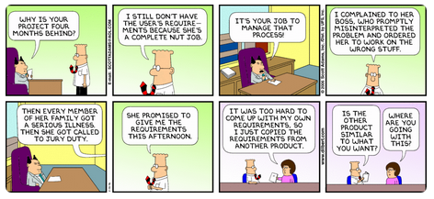
Notes:
Source: https://www.pinterest.com/pin/157696424423780855/

Slide 3
Objectives: Collect requirements – Tools & techniques (cont’d)
Data gathering:
Benchmarking
Brainstorming
Questionnaires/surveys
Data analysis:
Document analysis
Decision making:
Voting
Multi-criteria decision analysis
Data representation:
Affinity diagrams
Mind mapping
Prototypes
Remember! The assigned readings in this course describe several ITTOs for each PMBOK process.
For the exam, you will need to study/ memorize only the ITTOs that appear in the PPT slides in blue font.
If an ITTO is not shown in blue font, then you don’t need to memorize it for the exam!

Slide 4
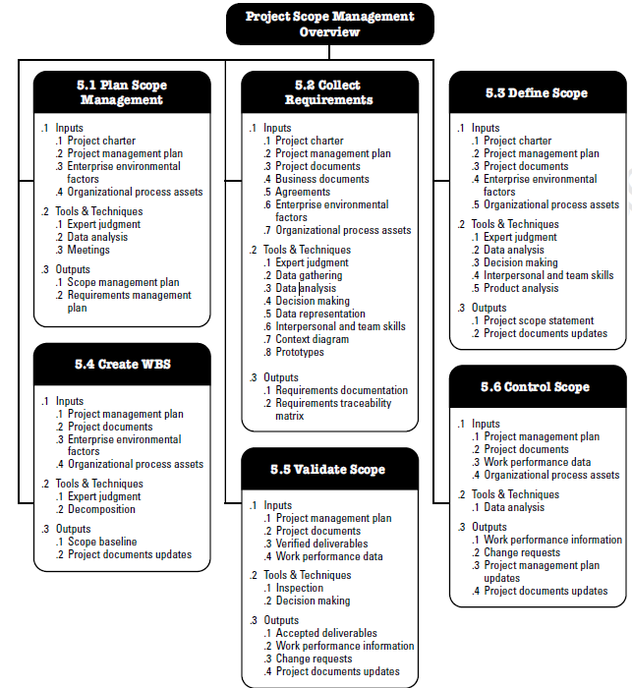
Recall from last module (in PMBOK 6th ed., p. 130)…
Notes:
Source: PMBOK 6th ed. (PMI)

Slide 5

Data gathering: Benchmarking, Brainstorming
Benchmarking: Comparing actual or planned practices to those of comparable products to identify best practices, generate ideas for improvement, or providing a basis for measuring performance
E.g., Youtube video – How video game developers might benchmark graphics speeds with different types graphics cards to determine appropriate frames per second: https://www.youtube.com/watch?v=GJoVjOk1SVY (start approx. 53 seconds into video, FPS = frames per second)
Brainstorming: Sharing your ideas, no matter how crazy they sound
Notes:
Image Source: http://www.linhartpr.com/wp-content/uploads/2016/06/brainstorm.jpg

Slide 6
Data gathering: Questionnaires/Surveys
Quick
Cheap (compared to in-person interviews)
Can get information for a large sample group
Results are tabulated and a summary of aggregated findings are produced (often using statistical procedures)
But…Don't ask too many questions – people will typically stop after 8 to 10 minutes
If survey is longer, let participants know in advance, and/or give them opportunity to complete survey at a later date

Slide 7
Questionnaires and Surveys
Closed-ended questions are best (analyzing open-ended questions is very time-consuming!)
A small number of open-ended questions can be included (with limited space to answer)
Likert scale (respondents choose their answer based on a scale from 1 to 5, 1 to 7, or 1 to 10)
Q1: Chocolate is great!
1 - strongly disagree
2 – disagree
3 – neither agree nor disagree
4 – agree
5 – strongly agree

Slide 8
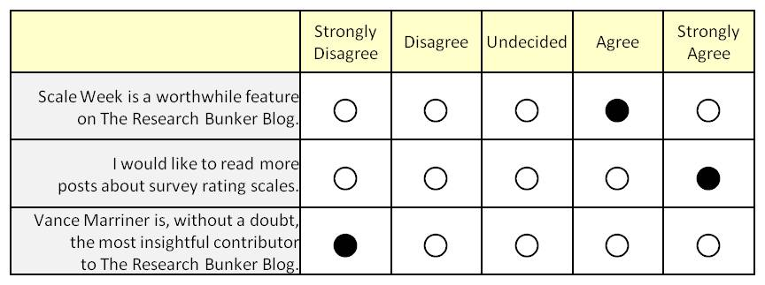
Questionnaires and Surveys

Slide 9
Questionnaires and Surveys
You may wish to ask two or three questions about the same construct (or concept), using different words and phrasing
Do you consider yourself as being an active person?
How many hours during a normal week are you physically active (number range)
How many hours a day do you watch television or surf the web?
(If the respondent indicates that he/she is an active person, you would expect that the answer to the second question would be a high number AND the answer to the third question would be a lower number. Asking questions this way helps increase the reliability/validity of the survey)

Slide 10
Questionnaires and Surveys
Multiple choice
Q1: What is your marital status? (check one only)
Single
Married
Divorced
Separated
Widowed
Other (please specify)
Some multiple choice questions are designed so that only one response is permitted. For other multiple choice questions, you may permit the respondent to select more than one answer. It’s helpful to indicate in your question whether you want the respondent to pick only ONE choice or whether they can select more than one answer…
It’s also helpful to provide an “other” option, and allow respondents to write in their “other” answer…

Slide 11

data analysis: Document Analysis
Analyzing existing documents to identify information relevant to project requirements
Examples might include building codes and other regulatory information, problem/issue logs, etc.
Notes:
Image source: https://www.google.ca/url?sa=i&rct=j&q=&esrc=s&source=images&cd=&cad=rja&uact=8&ved=2ahUKEwiar66rxuDdAhVC9YMKHYhZDAgQjRx6BAgBEAU&url=https%3A%2F%2Fwww.archives.gov%2Feducation%2Flessons%2Fworksheets&psig=AOvVaw0139M_lWMAvdbX9q6pBTg-&ust=1538321392182090

Slide 12

Decision-Making: voting
For making decisions about requirements:
Unanimity – everyone agrees on the requirement
Majority – more than 50% of the people agree on the requirement
Plurality – when there’s a choice of options, the choice that gets the most votes is the winner (even though it may not have received the numerical majority of votes)
Example: blue option – 3 out of 7 people vote for this option
green option - 2 out of 7 people vote for this option
red option – 2 out of 7 people vote for this option
Therefore, the blue option is picked, even though less than 50% of the group selected this option (a majority would have been 4 or more people voting for this option).

Slide 13
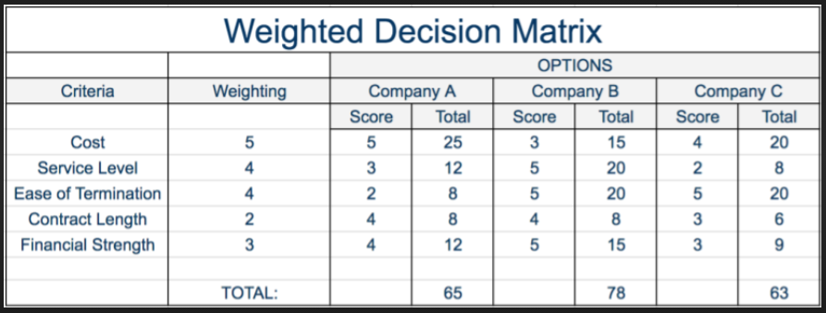
Decision making: multi-criteria decision analysis
Making decisions about what criteria are more important than others (weighted criteria)
Notes:
https://expertprogrammanagement.com/wp-content/uploads/2017/09/Weighted-Decision-Matrix-1.png

Slide 14
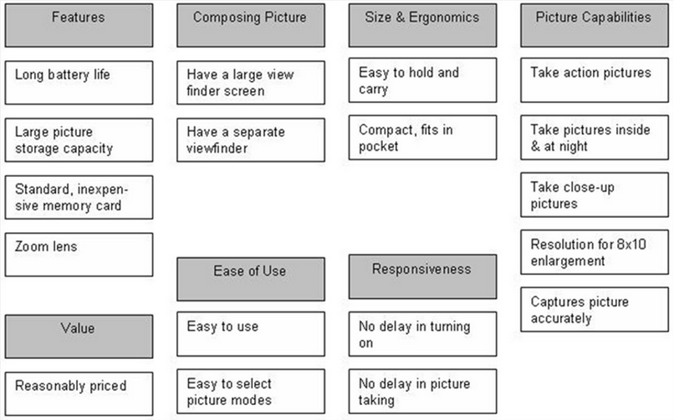
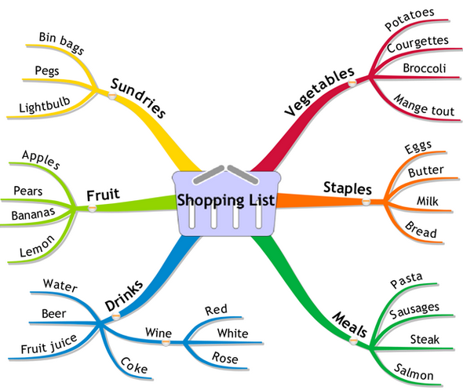
Data representation
Affinity Diagrams: Ideas are grouped into their natural relationships
Mind Maps: A visual/graphic way to represent groupings of ideas, using branches and sub-branches
Notes:
Mind map example: http://www.tomevans.co/2011/04/20/mapping-your-mind/

Slide 15
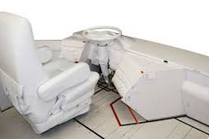

Prototype
Full-scale working model of something built for study, testing or display

Slide 16
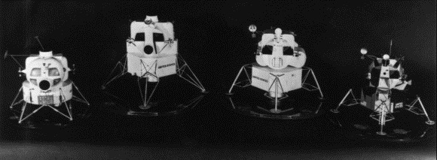
Prototype
Done in the early phases of a project
Allows the end user to touch, feel, see and to some degree use the end product
http://www.youtube.com/watch?v=mTJstCUWpY0
Development of NASA’s Apollo Lunar Landing Module:
https://www.youtube.com/watch?v=LXZNHCv2xQk

